Slide 1
Introduction to NLP
Clair Kronk
Department of Biomedical Informatics
University of Cincinnati, School of Medicine
Notes:
Make sure to load in project data before presentation
10:45 AM to 11:15 AM: NLP introduction
11:15 AM to 12:00 PM: NLP walkthrough

Slide 2
Natural Language Processing
Notes:
What is natural language processing?
Not neurolinguistic programming
What does this mean?
2 parts: NLG (Natural Language Generation) and NLU (Natural Language Understanding)

Slide 3

Why NLP?
Summarize long documents
Identify the author of an unknown document
Discover plagiarism
Examine sentiment trends
Correct spelling and grammar
Create chatbots
Autocomplete
Notes:
Why use NLP?
Author of an unknown document
Stylometry / Forensic linguistics
Look at suicide notes or historical documents (Shakespeare attribution studies)
Not always perfect though… A Funeral Elergy probably wasn’t Shakespeare’s
How do people feel about political candidates or new policies?
Autocomplete… Which is always perfect
But not NLP can even write movies!

Slide 4
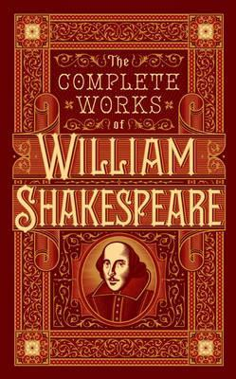

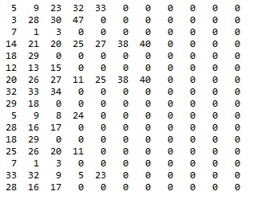
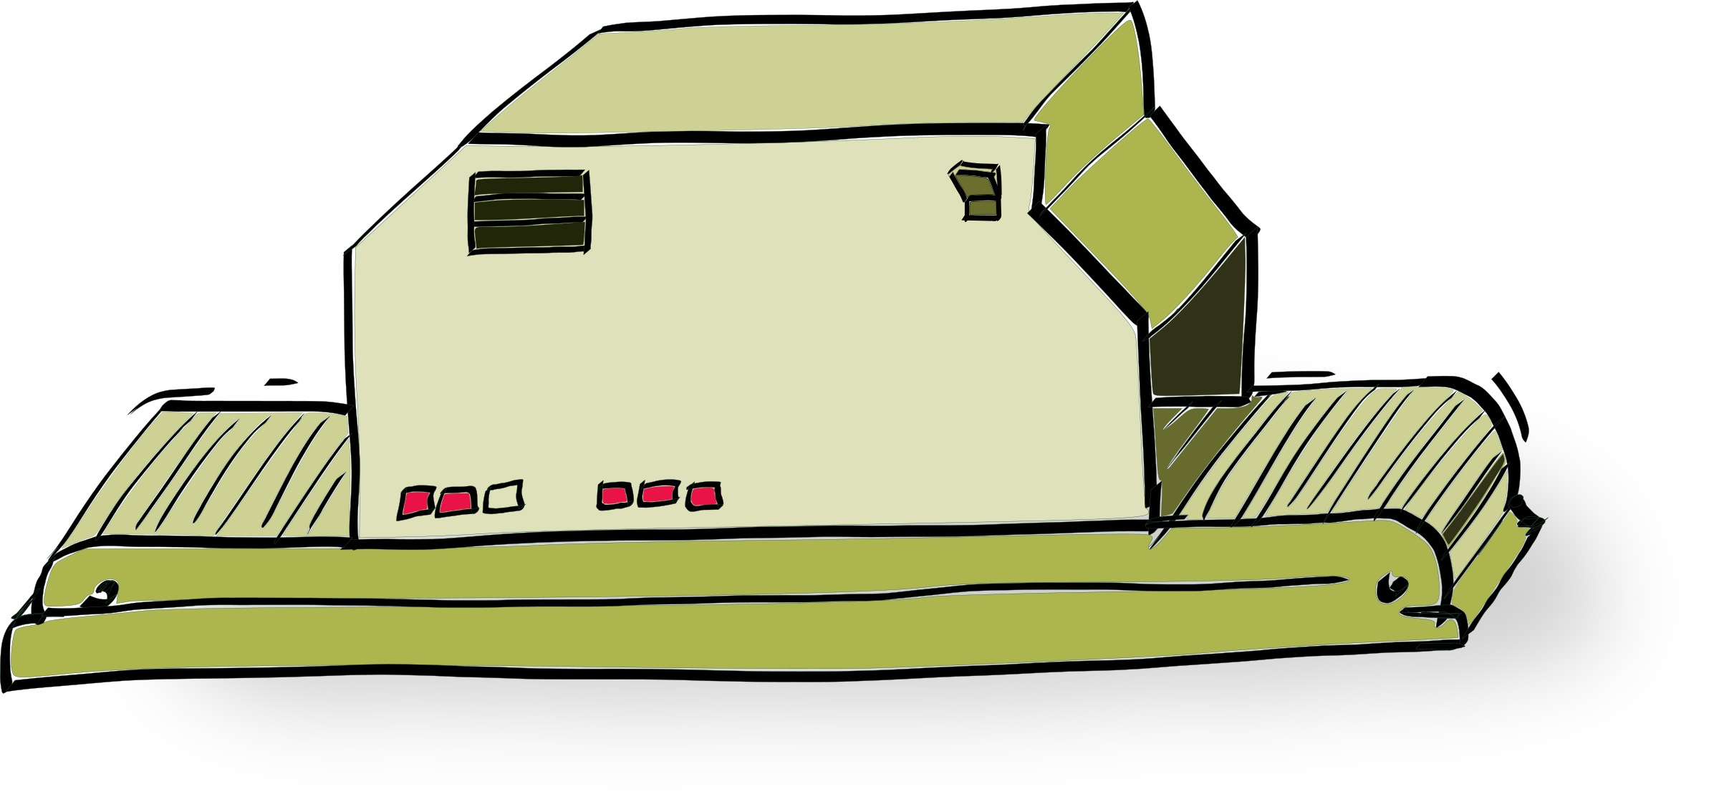
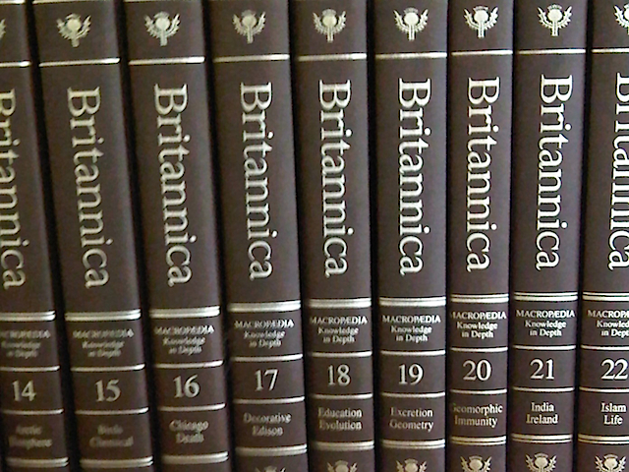

Modeling
Notes:
Oh no! Computers can only understand numbers!
How do we change language into numbers?

Slide 5
Modeling
VECTORIZER
Notes:
Oh no! Computers can only understand numbers!
How do we change language into numbers?

Slide 6
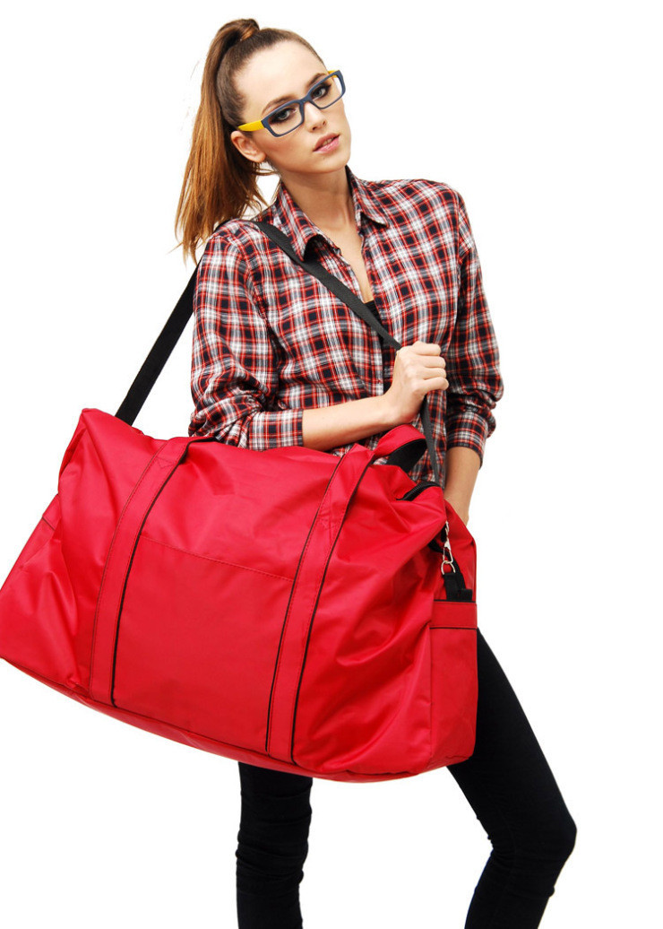
Bag of Words
WORDS
Notes:
https://medium.com/greyatom/an-introduction-to-bag-of-words-in-nlp-ac967d43b428

Slide 7
Bag of Words
The snow glows white on the mountain tonight /
Not a footprint to be seen /
A kingdom of isolation /
And it looks like I’m the queen
WORDS

Slide 8
Bag of Words
The snow glows white on the mountain tonight /
Not a footprint to be seen /
A kingdom of isolation /
And it looks like I’m the queen
WORDS
the | 3 | to | 1 | on | 1
a | 2 | snow | 1 | of | 1
white | 1 | seen | 1 | not | 1
tonight | 1 | queen | 1 | … | …

Slide 9
Bag of Words
the (0) | 3 | to (4) | 1 | on (8) | 1
a (1) | 2 | snow (5) | 1 | of (9) | 1
white (2) | 1 | seen (6) | 1 | not (10) | 1
tonight (3) | 1 | queen (7) | 1 | … | …
The snow glows white on the mountain tonight
WORDS
[2,0,1,1,0,1,0,0,1,0,0,…]

Slide 10
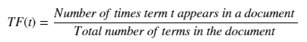
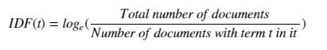
TF-IDF
+
=
Notes:
Term frequency-inverse document frequency

Slide 11
TF-IDF
“Storm” appears 4 times in “Let it Go”
There are 276 words in the song
The soundtrack has 32 songs, but only 10 have lyrics
The word “storm” also appears in “For the First Time in Forever (Reprise)” and “In Summer”
How do we calculate TF and IDF?
+
=
Notes:
Term frequency-inverse document frequency
TF = 4 / 276
IDF = log_e(10 / 3) =~ 1.204

Slide 12
TF-IDF
=
How can we calculate from the last slide?
Notes:
Term frequency-inverse document frequency
(4 / 276) * 1.204 = 0.017
https://en.wikipedia.org/wiki/Tf%E2%80%93idf

Slide 13
Cleaning Data
Case normalization
Removing stop words
Removing punctuation
Removing special symbols
Lemmatization / Stemming

Slide 14
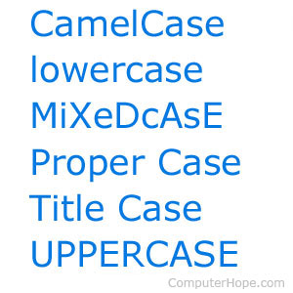
Cleaning Data
Case normalization
Removing stop words
Removing punctuation
Removing special symbols
Lemmatization / Stemming

Slide 15
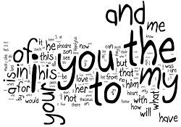

Cleaning Data
Case normalization
Removing stop words
Removing punctuation
Removing special symbols
Lemmatization / Stemming

Slide 16
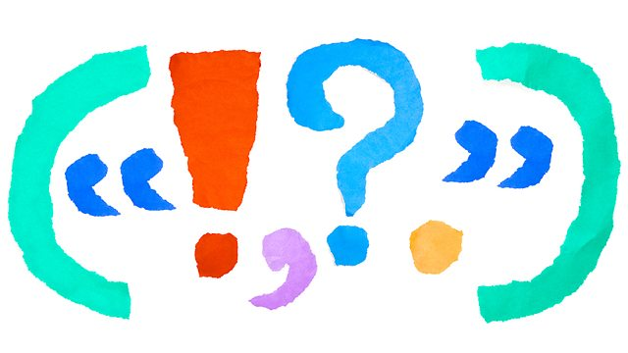
Cleaning Data
Case normalization
Removing stop words
Removing punctuation
Removing special symbols
Lemmatization / Stemming
Notes:
We might also want to remove numerics.

Slide 17
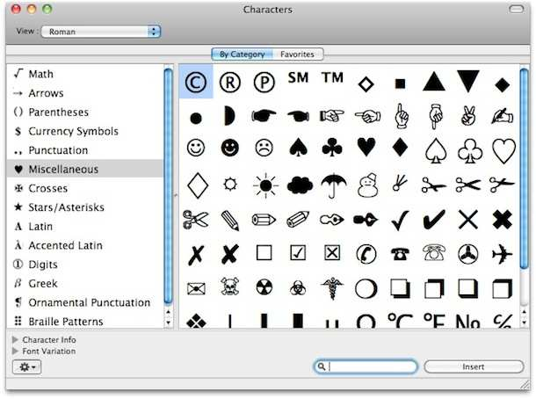
Cleaning Data
Case normalization
Removing stop words
Removing punctuation
Removing special symbols
Lemmatization / Stemming

Slide 18
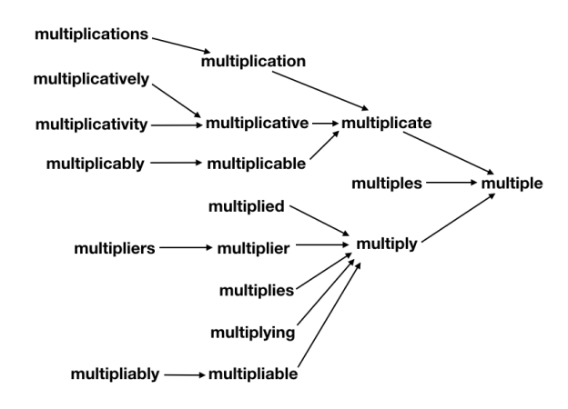
Cleaning Data
Case normalization
Removing stop words
Removing punctuation
Removing special symbols
Lemmatization / Stemming

Slide 19
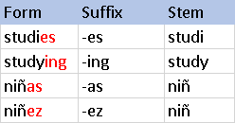
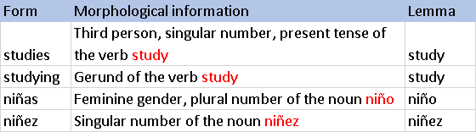
Cleaning Data
Case normalization
Removing stop words
Removing punctuation
Removing special symbols
Lemmatization / Stemming
Notes:
Stemming and Lemmatization both generate the root form of the inflected words. The difference is that stem might not be an actual word whereas, lemma is an actual language word. Stemming follows an algorithm with steps to perform on the words which makes it faster.

Slide 20
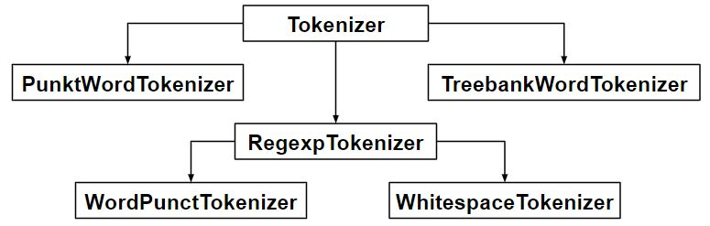
Tokenization
Sentence tokenization
Word tokenization
Notes:
But first… What is a word?
What is a sentence?
How do we parse those?

Slide 21

Tokenization
Sentence tokenization
Word tokenization
Notes:
Punctuation!
Default in NLTK package is PunktSentenceTokenizer
Different versions for different languages

Slide 22
Tokenization
Sentence tokenization
Word tokenization
All right, Mr. DeMille, I’m ready for my close-up.
['All', 'right', ',', 'Mr.', 'DeMille', ',', 'I', "'m", 'ready', 'for', 'my', 'close-up', '.']
Notes:
By default we have the TreebankWordTokenizer in NLTK
Also uses punctuation and spaces

Slide 23
Tokenization
Sentence tokenization
Word tokenization
['Well', 'well', 'well', '...', 'Phone', 'Nonsense', 'Just', 'got', 'back', 'from', 'studio', '&', 'I', '’', 'm', 'Dead', '...', 'but', 'There', '’', 's', 'No', 'Hurry', 'Anymore', ',', 'When', 'All', 'Is', 'Said', '&', 'Done']
['Well', 'well', 'well', 'Phone', 'Nonsense', 'Just', 'got', 'back', 'from', 'studio', 'I', 'm', 'Dead', 'but', 'There', 's', 'No', 'Hurry', 'Anymore', 'When', 'All', 'Is', 'Said', 'Done']
Notes:
By default we have the TreebankWordTokenizer in NLTK
Also uses punctuation and spaces
Cher tweet:
“””
Well well well....Phone Nonsense
Just got back from studio & I’m Dead....but There’s No Hurry Anymore, When All Is Said & Done
“””
We can also use other methods:
TweetTokenizer [top]
MWETokenizer (re-merges multi-word expressions) (after using Treebank tokenizer)
RegexpTokenizer [bottom] (using regular expression “[\w’]+”)

Slide 24
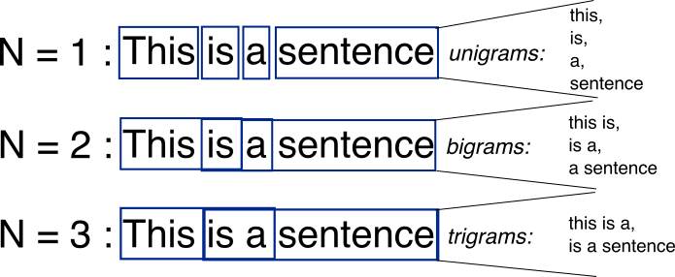
N-grams
Notes:
But sometimes we don’t just want individual words…
https://www.boredpanda.com/funny-english-language-jokes/
(contronyms)
Rock and roll
Brussel sprouts
Will Will Smith smith?
Guinea pig
Bigrams? Trigrams? Etc,

Slide 25
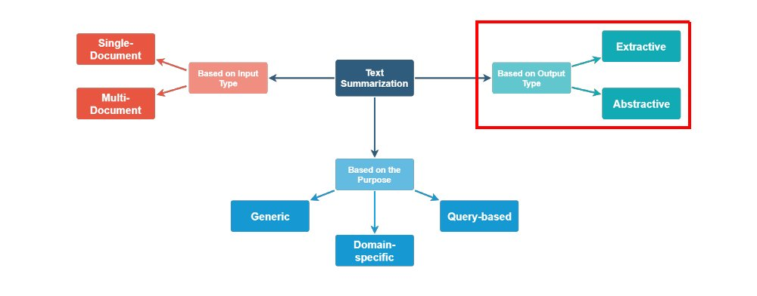
Summarization
Notes:
https://www.kdnuggets.com/2019/01/approaches-text-summarization-overview.html
Extractive → identifying important part or excerpts and reproducing them verbatim
Abstractive → more advanced, needs to generate new text

Slide 26
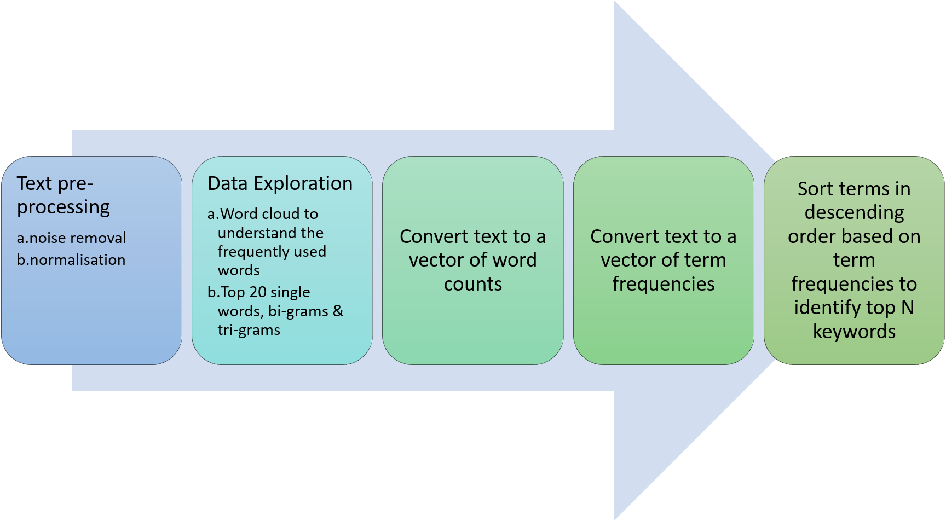
Automatic Keyword Generation
Notes:
https://medium.com/analytics-vidhya/automated-keyword-extraction-from-articles-using-nlp-bfd864f41b34

Slide 27
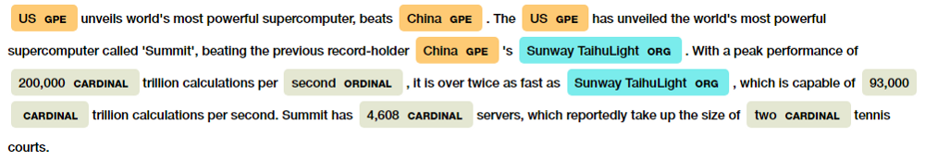
Named Entity Recognition (NER)
Notes:
https://medium.com/explore-artificial-intelligence/introduction-to-named-entity-recognition-eda8c97c2db1
https://en.wikipedia.org/wiki/Named-entity_recognition
https://www.kdnuggets.com/2018/08/named-entity-recognition-practitioners-guide-nlp-4.html
Named Entities → individuals, companies, places, organizations, cities, etc.
What could make this difficult?
John Smith versus John Smith, M.D.
The University of California, San Francisco instead of University of California, San Francisco
James Madison instead of James Madison University

Slide 28
Sentiment Analysis (SA)
3-Class Sentiment Analysis
Emotional Analysis
Notes:
https://en.wikipedia.org/wiki/Sentiment_analysis

Slide 29
Sentiment Analysis (SA)
3-Class Sentiment Analysis
Positive, Neutral, Negative
Emotional Analysis
I like this conference!
This presentation is happening.
I hate everything.
Notes:
https://en.wikipedia.org/wiki/Sentiment_analysis

Slide 30
Sentiment Analysis (SA)
3-Class Sentiment Analysis
Positive, Neutral, Negative
Emotional Analysis
I don’t dislike Kim Petras
If the weather were nice, then I’d love it!
Sometimes, I really can’t stand Joaquin Phoenix.
Notes:
https://en.wikipedia.org/wiki/Sentiment_analysis

Slide 31
Sentiment Analysis (SA)
WATSON
Social Tones
Openness
Conscientiousness
Extraversion
Agreeableness
Emotional Range
3-Class Sentiment Analysis
Emotional Analysis
Notes:
https://en.wikipedia.org/wiki/Sentiment_analysis
IBM Watson uses a machine learning model called a Support Vector Machine to detect one of 5 “social” tones
https://medium.com/@Mandysidana/top-five-emotional-sentiment-analysis-apis-116cd8d42055
Qemotion uses surprise, calm, fear, sadness/disappointment, anger, and disgust (about 85% accurate)
Long way from total range of human emotions
What are some potential applications?

Slide 32
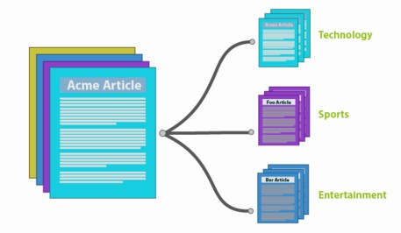
Classification
Training and testing sets
Inputs X (typically vectorized text)
Outputs Y (typically a sentiment determined by sentiment analysis or some other “category” system)
Let’s get to it!
Notes:
Most common andddd probably most complicated NLP task!
So many methods:
Multinomial NB

Slide 33

Useful Packages for NLP (Python)
CoreNLP
Gensim
Matplotlib
Natural Language Toolkit (NLTK)
Pandas
Polyglot
Requests
Sklearn
Stanford NLP
String
Sumy
Wordcloud
Wordninja
…And so many more!

Slide 34
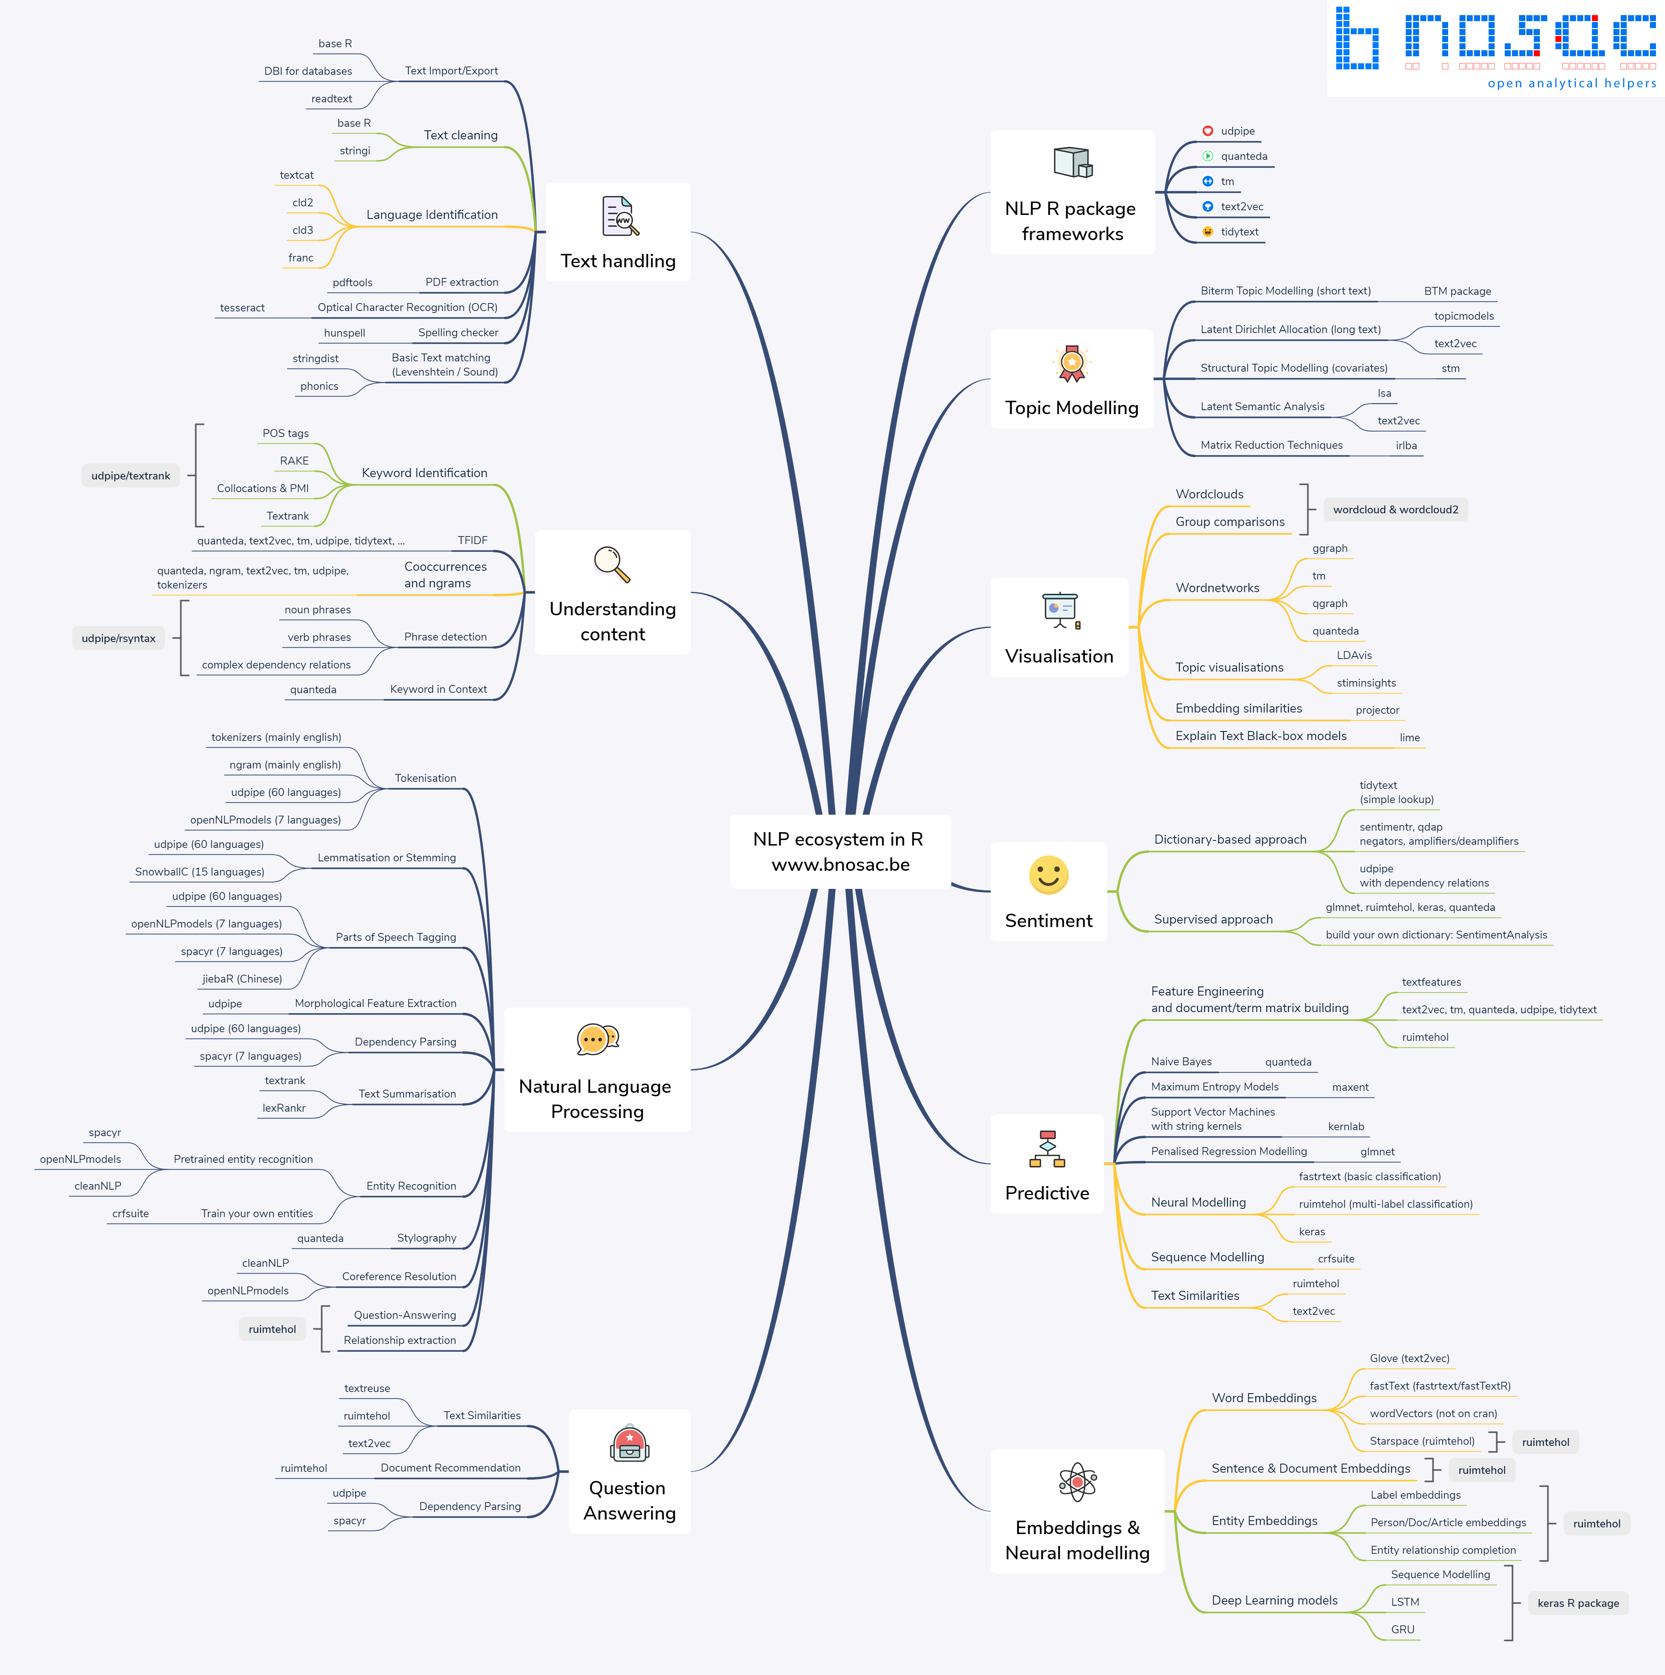
Useful Packages for NLP (R)
Dplyr
Ggplot2
Knitr
Magrittr
Plotly
Tidyr
Tidytext
Tm
Topicmodels
…And so many more!

